Slide 1
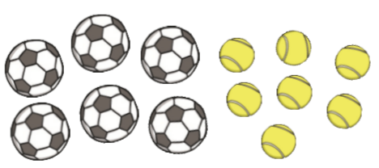
Maths Miss Smith and Mrs Moat’s groups (triangles and squares)
Day 1
LO: to know and complete fact families.
Fact families are groups of equations that share the name numbers for the parts and same number for the whole. They are usually made up of addition and subtraction equations. Watch this video to help you.
e.g.: Here is some fruit. I have got some apples and pears. Complete the part-part whole model and write the four equations it represents.
8 + 10 = 18
10 + 8 = 18
18 – 10 = 8
18 – 8 = 10
8
18
18 = 8 + 10
18 = 10 + 8
8 = 18 – 10
10 = 18 – 8
10
Complete the part-part whole model for this representation and write your eight equations.

Slide 2
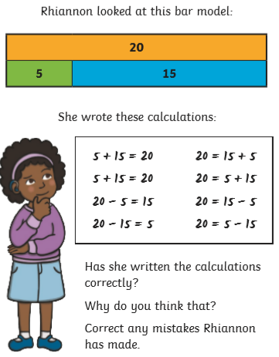
Maths Miss Smith and Mrs Moat’s groups (triangles and squares)
Day 1
LO: to know and complete fact families.
Complete the part-part whole model for this representation and write your eight equations.

Slide 3
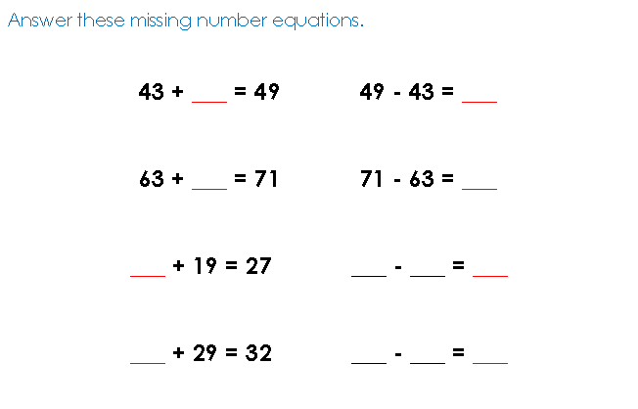
Maths Miss Smith and Mrs Moat’s groups (triangles and squares)
Day 2
LO: to answer inverse equations (addition)
Sometimes in our equations the missing number isn’t always after the equals sign. If the missing number is first or in the middle and its an addition of the equation, we have to tweak it a little, and change our equation to help us find the answer.
If the missing part is first, put it in reverse.
6 + __ = 10 10 - 6 = __
__ + 6 = 10 10 - 6 = __
6
10

Slide 4
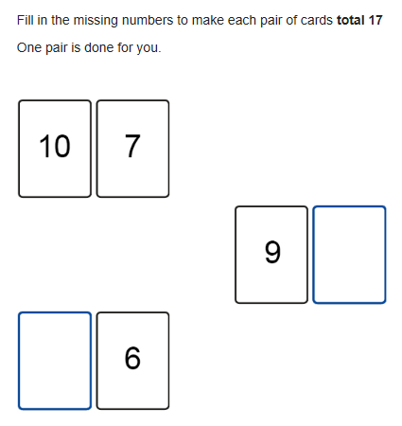
Maths Miss Smith and Mrs Moat’s groups (triangles and squares)
Day 2
LO: to answer inverse equations (addition)
Answer these missing number equations. Remember, is the missing number’s addition so is first or in the middle, put it in reverse!
9 + ___ = 17
32 + __ = 35
63 + __ = 71
45 + __ = 50
__ + 13 = 20
__ + 64 = 72
__ + 72 = 80
__ + 51 = 59

Slide 5
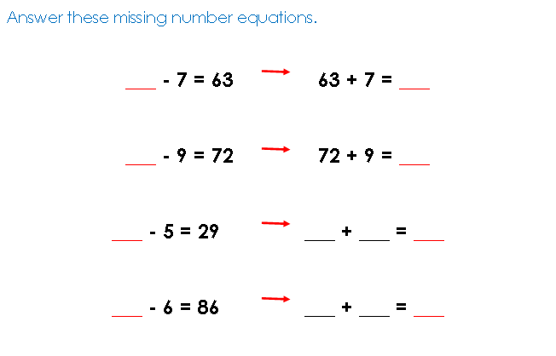
Maths Miss Smith and Mrs Moat’s groups (triangles and squares)
Day 3
LO: to answer inverse equations (subtraction)
There are two rules for subtraction missing number equations. This is the rule for if the missing part is first. We are also follow our inverse rule if it is a subtraction equation.
If the missing part is first, put it in reverse.
__ - 8 = 23 23 + 8 = __
8
23

Slide 6
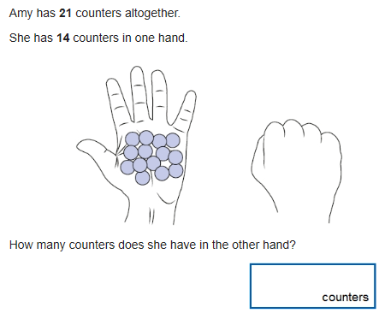
Maths Miss Smith and Mrs Moat’s groups (triangles and squares)
Day 3
LO: to answer inverse equations (subtraction)
Answer these missing number equations. Remember, is the missing number’s first, put it in reverse!
___ - 3 = 32
___ - 9 = 87
___ - 5 = 18
___ - 12 = 45
___ - 20 = 45
___ - 32 = 12
___ - 25 = 11
___ - 15 = 30
___ - 10 = 50

Slide 7
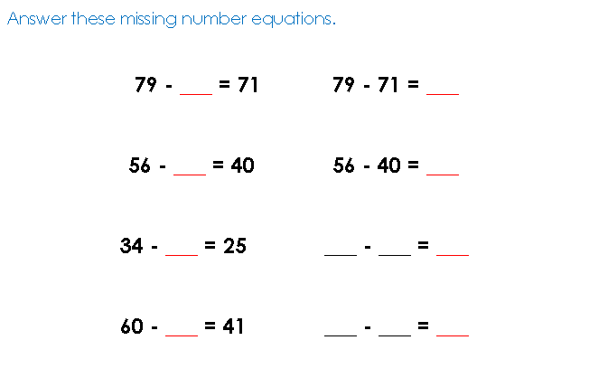
Maths Miss Smith and Mrs Moat’s groups (triangles and squares)
Day 4
LO: to answer inverse equations (subtraction)
If we are answering subtraction equations where the missing number is in the middle, we have to give it a little wiggle!
If the missing part is in the middle, give it a wiggle.
23 - __ = 15 23 - 15 = __
15
23

Slide 8
Maths Miss Smith and Mrs Moat’s groups (triangles and squares)
Day 4
LO: to answer inverse equations (subtraction)
Answer these missing number equations. Remember, is the missing number’s in the middle, give it a wiggle!
45 - ___ = 39
59 - ___ = 40
90 - ___ = 81
38 - ___ = 29
19 - ___ = 2
100 - ___ = 79
82 - ___ = 74
35 - ___ = 25

Slide 9
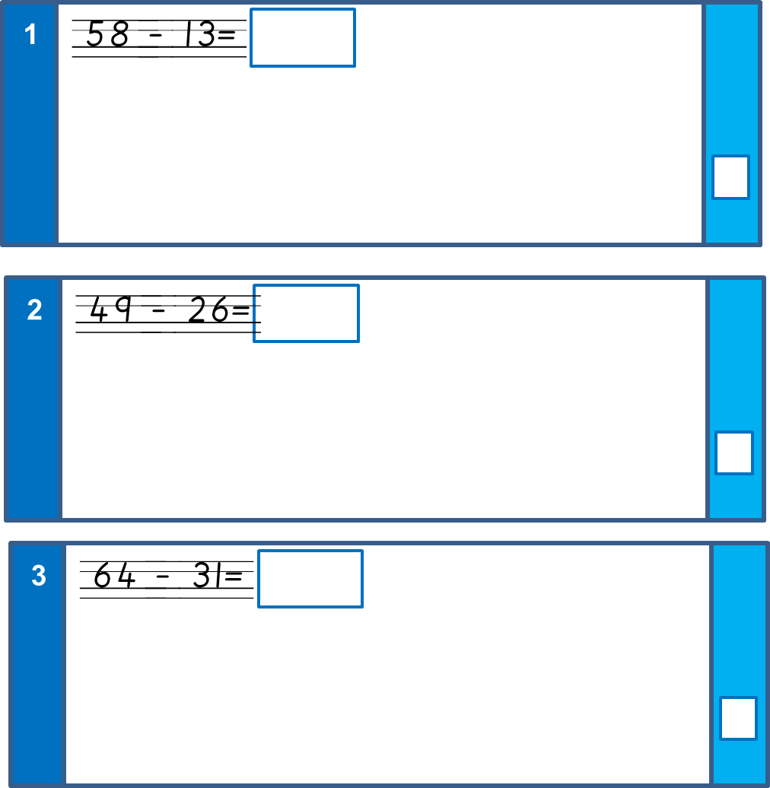
Maths Miss Smith and Mrs Moat’s groups (triangles and squares)
Day 5
LO: to answer mixed arithmetic questions
91 – 12 =
45 + 19 =
3 x 10 =
4
18 + 5 + 2 =

Slide 10
Maths Miss Smith and Mrs Moat’s groups (triangles and squares)
Day 5
LO: to answer mixed arithmetic questions
5
½ of 10 =
6
1/3 of 9 =
7
15 ÷ 5 =
8
40 ÷ 4 =
9
40 – 5 =

